Slide 1
Foundations of R for Bioinformatics
Dr Matthew Taylor
Institute of Cancer and Genomic Sciences
College of Medicine and Health
m.taylor.1@bham.ac.uk

Slide 2
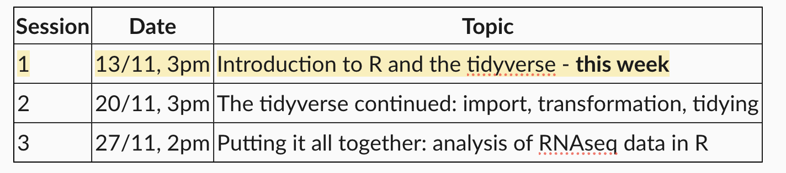
Course structure

Slide 3
Initial setup—ideally before first session
Go to https://posit.co/download/rstudio/
Follow the instructions for downloading and installing R and RStudio
Go to https://github.com/MattTaylor1209/MRes-R-course/
Click Code – Download Zip. Extract to a destination of your choice.
Open that folder (Mres-R-course-main) and double click the file “Foundations of R for bioinformatics.Rproj”—it should open in RStudio.
In RStudio, click File – Open File – setup.R
Click the source button
Then File – Open File - navigate to the Session_1 folder and open Session_1.qmd

Slide 4
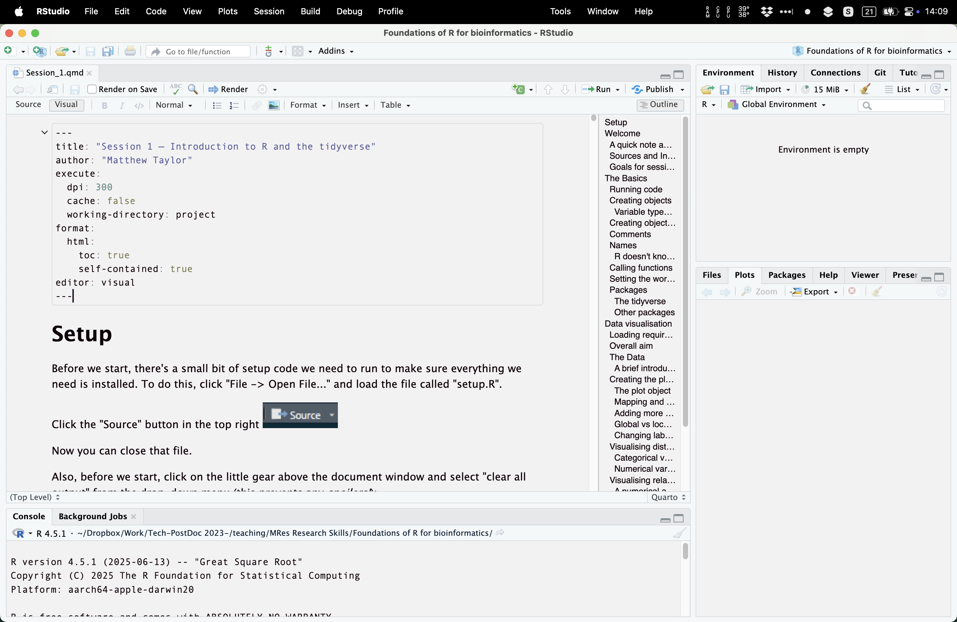
You should then see something like this

